Slide 1
A Coherent and Managed Runtime for ML on the SCC
KC Sivaramakrishnan Lukasz Ziarek Suresh Jagannathan
Purdue University SUNY Buffalo Purdue University

Slide 2
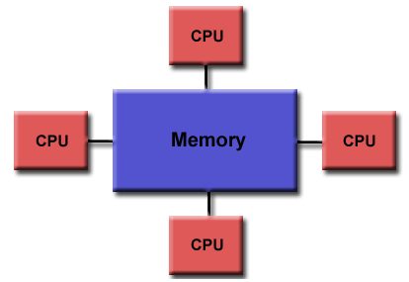
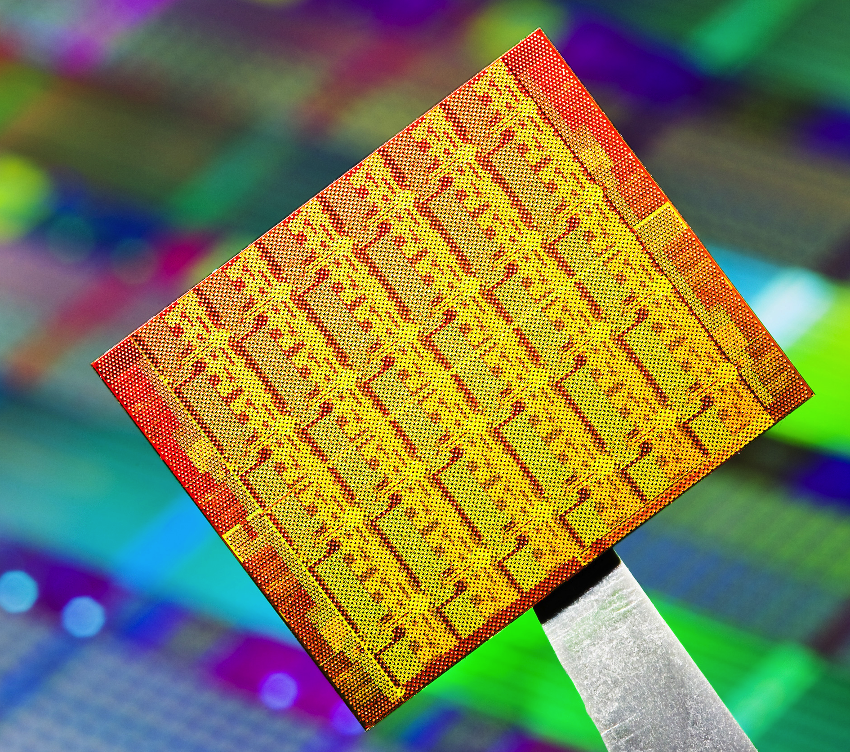

Big Picture
Cache Coherent
Intel SCC
Cluster of Machines
??
No change to programming model
Automatic memory management
No cache coherence
Message passing buffers
Distributed programming
RCCE, MPI, TCP/IP
Shared memory
Software Managed Cache-Coherence (SMC)
Can we program SCC as a cache coherent machine?

Slide 3
Intel SCC Architecture
_{No Cache-Coherence}
_{(Caching disabled)}
_{Software Managed Cache}
_{(Release Consistency)}
_{Shared Memory}
_{(off chip)}
_{Private Memory}
_{Private Memory}
_{Private Memory}
...
_{Private Memory}
_{Core 0}
_{Core 1}
_{Core 2}
_{Core 47}
_{Message Passing Buffers}
_{(On die, 8KB per core)}
How to provide an efficient cache coherence layer?

Slide 4
SMP Programming Model for SCC
Desirable properties
Single address space
Cache coherence
Sequential consistency
Automatic memory management
Utilize MPB for inter-core communication
Abstraction Layer – MultiMLton VM
A new GC to provide coherent and managed global address space
Mapping first-class channel communication on to the MPB
Program
Abstraction Layer
SCC

Slide 5
Programming Model
MultiMLton
Safety, scalability, ready for future manycore processors
Parallel extension of MLton – a whole-program, optimizing Standard ML compiler
Immutability is default, mutations are explicit
ACML – first-class message passing language
send (c, v)
C
v ← recv (c)
Automatic memory management
Notes:
* sharing mutable objects

Slide 6
Coherent and Managed Address Space
Notes:
* Slide 2 -- Summary – Problem of too many -- How can efficient program these resources?
Slide 5,6 -- Automatic memory management. Think about combining the slides. Titles.
* Slide 17,18 -- Summary -- sender blocks, value is local, receiver appears, message is transferred over the MPB.
* Slide 19 -- Rename the lines

Slide 7
Coherent and Managed Address Space
Requirements
Single global address space
Memory consistency
Independent core-local GC
Thread-local GC!
Private-nursery GC
Local heap GC
On-the-fly GC
Thread-specific heap GC

Slide 8
Thread-local GC for SCC
Caching disabled
SMC - Caching enabled
Shared Memory
Uncached Shared Heap
(Mutable Objects)
Cached Shared Heap
(Immutable Objects)
Local Heap
Local Heap
Local Heap
…
Private
Memory
Private
Memory
Private
Memory
Core 0
Core 0
Core 0
Consistency preservation
No inter-coherence-domain pointers!
Independent collection of local heaps
Notes:
* Emphasize that local heap can be collected locally, and there are no inter-coherence domain pointers.

Slide 9
Heap Invariant Preservation
Uncached Shared Heap
Cached Shared Heap
Uncached Shared Heap
Cached Shared Heap
r_{m}
r_{m}
x_{m}
y_{im}
r := x
Write barrier -- Globalization
Local Heap
Local Heap
x_{m}
y_{im}
FWD
FWD
Mutator needs Read Barriers!

Slide 10
Maintaining Consistency
Local heap objects are not shared by definition
Uncached shared heap is consistent by construction
Cached shared heap (CSH) uses SMC
Invalidation and flush has to be managed by the runtime
Unwise to invalidate before every CSH read and flush after every CSH write
Solution
Key observation: CSH only stores immutable objects!

Slide 11
Ensuring Consistency (Reads)
Maintain MAX_CSH_ADDR at each core
Assume values at ADDR < MAX_CSH_ADDR are up-to-date
Up-to-date
Stale
Up-to-date
Stale
Uncached Shared Heap
Cached Shared Heap
0: read(x)
Uncached Shared Heap
Cached Shared Heap
MAX_CSH_ADDR
X
Invalidate before read – smcAcquire()
MAX_CSH_ADDR == X
Cache invalidation combined with read barrier

Slide 12
Ensuring Consistency (Reads)
No need to invalidate before read (y) where
y < MAX_CSH_ADDR
Why?
Bump pointer allocation
All objects in CSH are immutable
y < MAX_CSH_ADDR → Cache invalidated after y was created
Notes:
(1)Heap grows from left to right
(2) Recall that the objects in CSH are immutable objects. The value of immutable objects, by definition, will not change after allocation.
Since MAX_CSH_ADDR is > y, it must be the case that we have read a CSH address which is greater than order equal to y. Hence, we would have performed an invalidation after the object y was allocated. Hence, there is no need to perform invalidation during read of y.

Slide 13
Ensuring Consistency (Writes)
Writes to shared heap occurs only during globalization
Flush cache after globalization
smcRelease()
Cache flush combined with write barrier

Slide 14
Garbage Collection
Local heaps are collected independently!
Shared heaps are collected after stopping all of the cores
Proceeds in SPMD fashion
Each core prepares the shared heap reachable set independently
One core collects the shared heap
Sansom’s dual mode GC
A good fit for SCC!

Slide 15
GC Evaluation
8 MultiMLton benchmarks
48% faster
Memory Access profile
89% local heap, 10% cached shared heap, 1% uncached shared heap
Almost all accesses are cacheable!
Notes:
* At 48 cores, 48% faster than using a single shared heap.

Slide 16
ACML Channels on MPB
Notes:
* Slide 2 -- Summary – Problem of too many -- How can efficient program these resources?
Slide 5,6 -- Automatic memory management. Think about combining the slides. Titles.
* Slide 17,18 -- Summary -- sender blocks, value is local, receiver appears, message is transferred over the MPB.
* Slide 19 -- Rename the lines

Slide 17
ACML Channels on MPB
Challenges
First-class objects
Multiple senders/receivers can share the same channel
Unbounded
Synchronous and asynchronous
A blocked communication does not block core
Channel Implementation
datatype ‘a chan = {sendQ : (‘a * unit thread) Q.t,
recvQ : (‘a thread) Q.t}

Slide 18
Specializing Channel Communication
Message mutability
Mutable messages must be globalized
Must maintain consistency
Immutable messages can utilize MPB
Notes:
Explain all of the cases from the sender’s perspective. The receiver case will be the dual of this.
Case 1 is straight-forward, and requires no special handling

Slide 19
Sender Blocks
Channel in shared heap, message is immutable and in local heap
Shared Heap
Shared Heap
C
C
t1:send(c,v)
Local Heap
Local Heap
Local Heap
Local Heap
t1
V_{im}
t2
t1
V_{im}
t2
Core 0
Core 1
Core 0
Core 1

Slide 20
Receiver Interrupts
Shared Heap
Shared Heap
C
C
t2: recv(c)
Local Heap
Local Heap
Local Heap
Local Heap
t1
V_{im}
t2
t1
V_{im}
t2
V_{im}
Core 1 interrupts core 0 to initiate transfer over MPB
Core 0
Core 1
Core 0
Core 1

Slide 21
Message Passing Evaluation
SHM
MPB
On 48-cores, MPB only 9% faster
Inter-core interrupt are expensive
Context switches + idling cores + small messages
Polling is not an option due to user-level threading

Slide 22
Conclusion
Cache coherent runtime for ML on SCC
Thread-local GC
Single address space, Cache coherence, Concurrent collections
Most memory accesses are cacheable
Channel communication over MPB
Inter-core interrupts are expensive

Slide 23

Questions?
http://multimlton.cs.purdue.edu

Slide 24
Read Barrier
pointer readBarrier (pointer p) {
if (getHeader (p) == FORWARDED) {
//A globalized object
p = *(pointer*)p;
if (p > MAX_CSH_ADDR) {
smcAcquire ();
MAX_CSH_ADDR = p;
}
}
return p;
}

Slide 25
Write Barrier
val writeBarrier (Ref r, Val v) {
if (isObjptr (v) && isInSharedHeap (r) &&
isInLocalHeap (v)) { v = globalize (v);
smcRelease ();
}
return v;
}

Slide 26
Case 4
Channel in shared heap, message is mutable and in local heap
Shared Heap
Shared Heap
C
C
V_{m}
t1:send(c,v)
Globalize the mutable message
Local Heap
Local Heap
t1
V_{m}
t1

Slide 27
Case 2
Channel in Shared heap, Primitive-valued message
Shared Heap
Shared Heap
C
C
t1:send(c,0)
Local Heap
Local Heap
t1
t1
Remembered
Set

Slide 28
Case 3 – Sender Blocks
Channel in shared heap, message in shared heap
Shared Heap
Shared Heap
C
V
C
V
t1:send(c,v)
Local Heap
Local Heap
Local Heap
Local Heap
t1
t2
t1
t2
Core 0
Core 1
Core 1
Remembered
Set

Slide 29
Case 3 – Receiver Unblocks
Shared Heap
Shared Heap
C
V
C
V
t2:recv(c)
Local Heap
Local Heap
Local Heap
Local Heap
t1
t2
t1
t2
Core 0
Core 1
Core 0
Core 1

